Slide 1
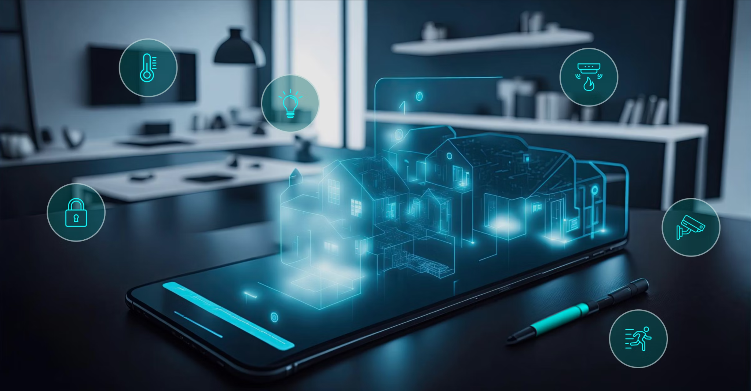

Team 61: Smart Home Automation
Bi-Weekly Update 2 Nick Tool, Tyler Mayou, Matthew McLean Sponsor: Souryendu Das TA: Fahrettin Ay
Notes:
Michelle

Slide 2
Project Summary
The Problem: “Smart home systems are often composed of many different components from different companies. This can make it very difficult for a user to combine devices and implement a fully functional system for their own personal living or working space.”
Our Goal: “Develop a basic smart home automation system that allows users to control a few essential home appliances (like lights and speakers) via a mobile app and a simple web interface. The system will use IoT/non-IoT devices and a local server and online database.”
Notes:
Kyle

Slide 3
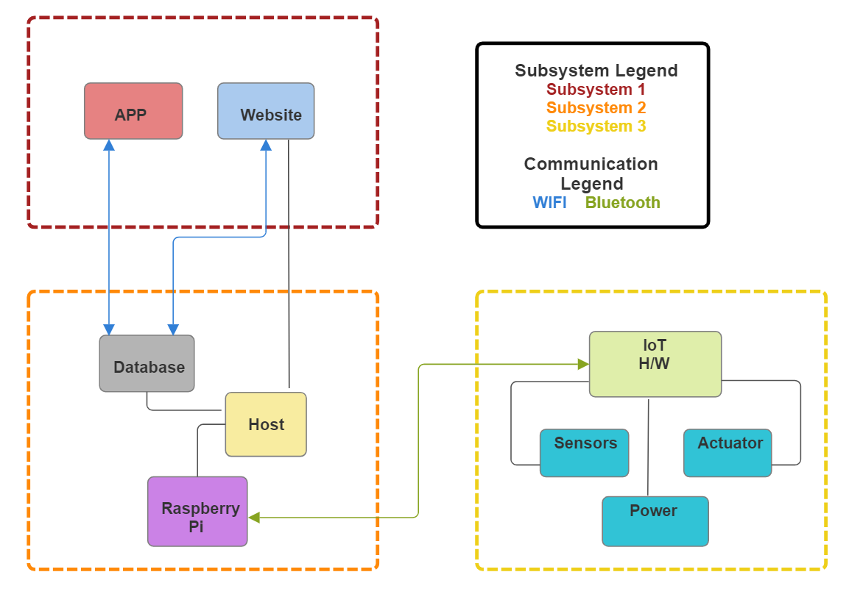
Project/Subsystem Overview
Matthew McLean
Tyler Mayou
Nick Tool
Notes:
Eric

Slide 4
Project Timeline
Green done, Yellow underway, White not started
Subsystem Designs and Testing (to complete 2/10) | Integration of App and Website (to complete 2/24) | Integration of IoT Hardware (to complete by 3/10) | Final Integration (to complete by 3/17) | System Test (to complete by 3/24) | Validation (to complete by 4/7) | Demo and Report (to complete by 4/21)
Notes:
Eric

Slide 5
Mobile and Web App
Matthew McLean
Accomplishments since last update 15 hrs of effort | Ongoing progress/problems and plans until the next presentation
Updated mobile app layouts Gradient Background Scrolling Grid layout for button symmetry adding detail to buttons Helped get Web App on the PI for hosting Preparations done for using server’s API | Goal for next presentation: Update status on web app by clicking button on mobile app. Clarify with sponsor/Add functionality to add and delete devices

Slide 6
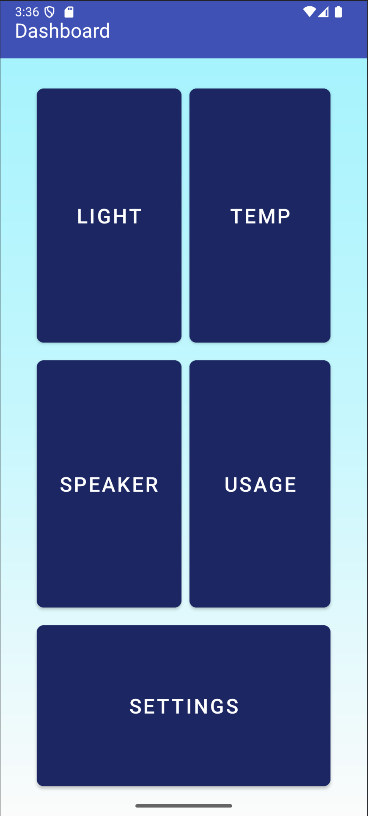
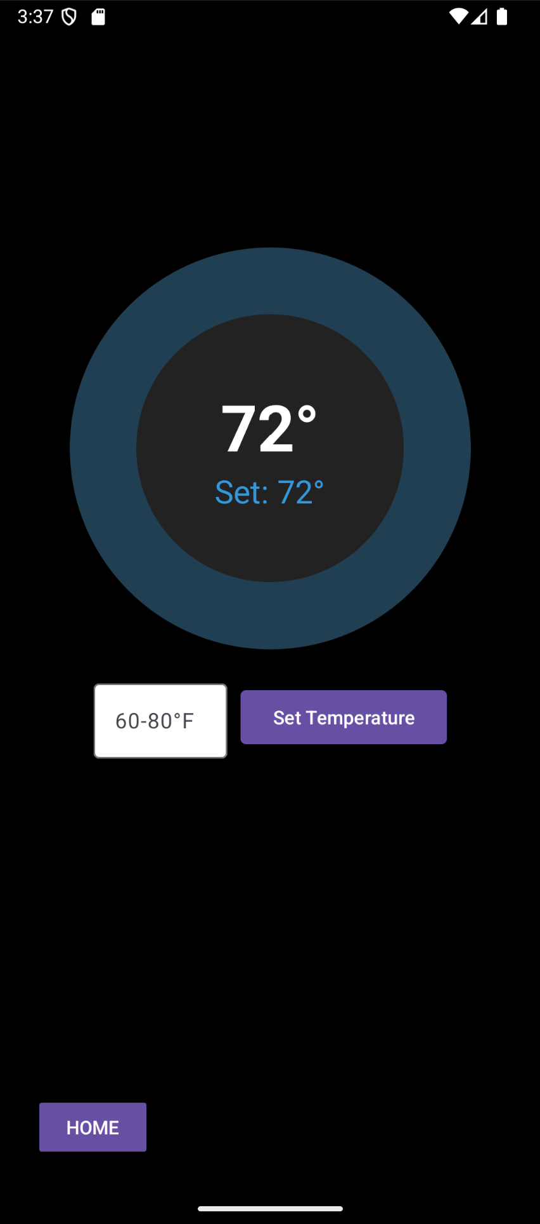
Mobile and Web App
Matthew McLean

Slide 7
IoT Hardware
Tyler Mayou
Accomplishments since last update 20 hrs of effort | Ongoing progress/problems and plans until the next presentation
All parts have been ordered Modifications for adding light bulb include AC dimming module using PWM from ESP32 to control New Power Supply for board and Raspberry PI | Order PCB this week and solder parts once it arrives Begin Integration with Host-subsystem

Slide 8
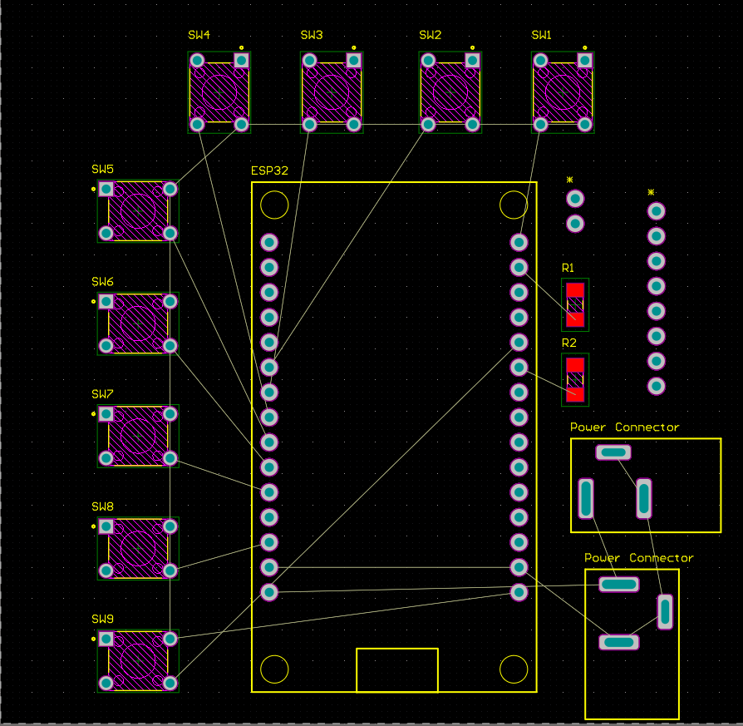
IoT Hardware
Tyler Mayou
Order Date | Part Number | Item Name | Location to Buy From | Cost per Part | Quantity | Total Cost
1/29/2025 |  | Power Supply from board to PI | Amazon | $8.99 | 1 | $8.99
1/29/2025 | SGAS60U05-P1J | Power Supply | Amazon | $12.99 | 1 | $12.99
1/29/2025 | 54-00131 | Barrel Connectors (PCB) | DigiKey | $0.77 | 2 | $1.54
1/29/2025 |  | PWM AC Dimmer Module | eBay | $11.99 | 1 | $11.99
1/29/2025 |  | Light Socket + Plug | Amazon | $8.99 | 1 | $8.99
1/29/2025 | PPTC081LFBN-RC | 8 pin Header | DigiKey | $0.56 | 1 | $0.56
1/29/2025 | PPTC021LFBN-RC | 2 pin header | DigiKey | $0.26 | 1 | $0.26
1/29/2025 | PPTC151LFBN-RC | 15 pin header | DigiKey | $0.89 | 2 | $1.78
1/29/2025 | TL1105DF160Q | tactile switches (buttons) | DigiKey | $0.20 | 10 | $1.96
1/29/2025 | 61300811121 | 8 pin male header | DigiKey | $0.36 | 1 | $0.36
1/29/2025 |  | Jumpers 40pcs 20cm | Amazon | $6.49 | 1 | $6.49
 |  |  |  |  |  | $55.91
Parts order Spreadsheet
PCB almost finished
Need to finish netting and board layout
Decided to allow some parts to be movable using headers and jumpers

Slide 9
Database and Host
Nicholas Tool
Accomplishments since last update 20 hrs of effort | Ongoing progress/problems and plans until the next presentation
Added public IP functionality Added security protocols for public access Got all front-end files up on Raspberry Pi | Full Integration with Website and Mobile App Main Issue: Button Functionality

Slide 10
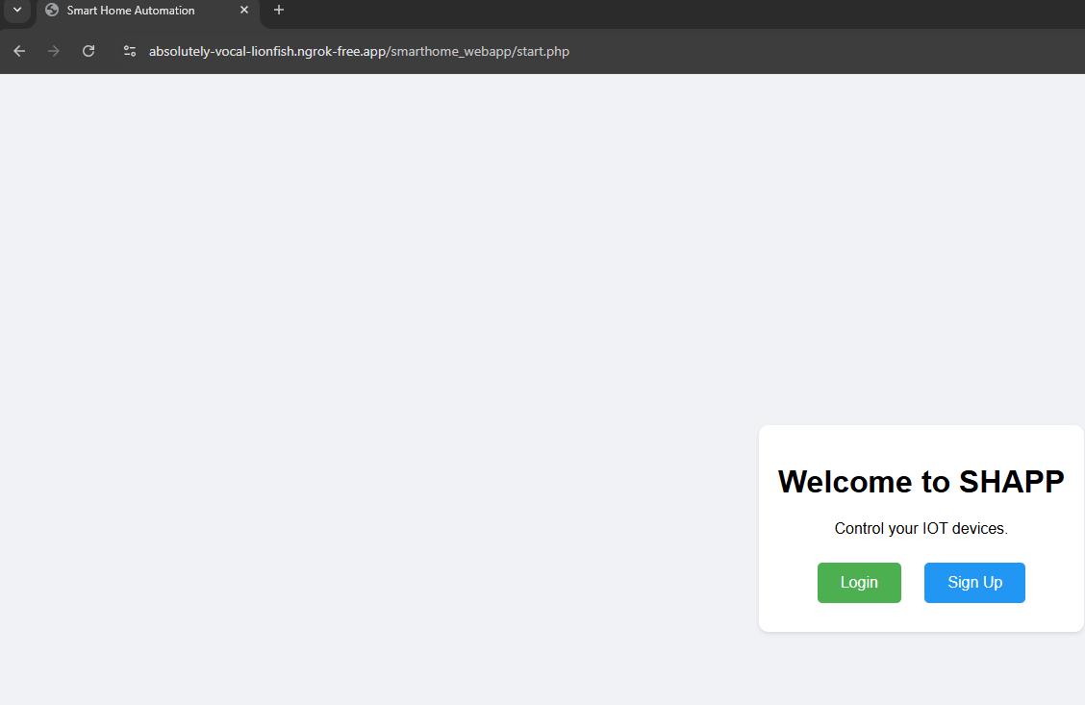
Database and Host
Nicholas Tool

Slide 11
Execution & Plan
 | 1/20 | 1/27 | 2/3 | 2/10 | 2/17 | 2/24 | 3/3 | 3/10 | 3/17 | 3/24 | 3/31 | 4/7 | 4/14 | 4/21 | 4/28 | Legend
Matthew McLean |  |  |  |  |  |  |  |  |  |  |  |  |  |  |  | Finished
Update Layout Of Website |  |  |  |  |  |  |  |  |  |  |  |  |  |  |  | Working on it
Integrate System with Host Server |  |  |  |  |  |  |  |  |  |  |  |  |  |  |  | Haven’t Started
Integrate Entire System
Nick Tool
Implement Public IP address
Implement Security Features
Integrate Host System with Mobile App and Website
Integrate Host System with IoT Hardware
Validate App & Website Integration
Validate IoT Hardware Integration
Test and Validate Basic Functions in Fully Integrated System
Test Edge Cases in Fully Integrated System
Tyler Mayou
Discuss 404 modifications
Order parts for modification
Order NEW PCB
Hardware integration
Team
Update #2
Update #3
Update #4
Update #5
Final Presentation
Final Demo
Final Report
Integration
System Test
Validation

Slide 12
Thanks and Gig ‘Em

